Slide 4
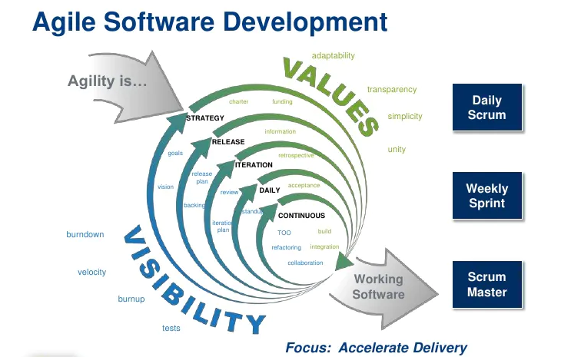

Slide 9
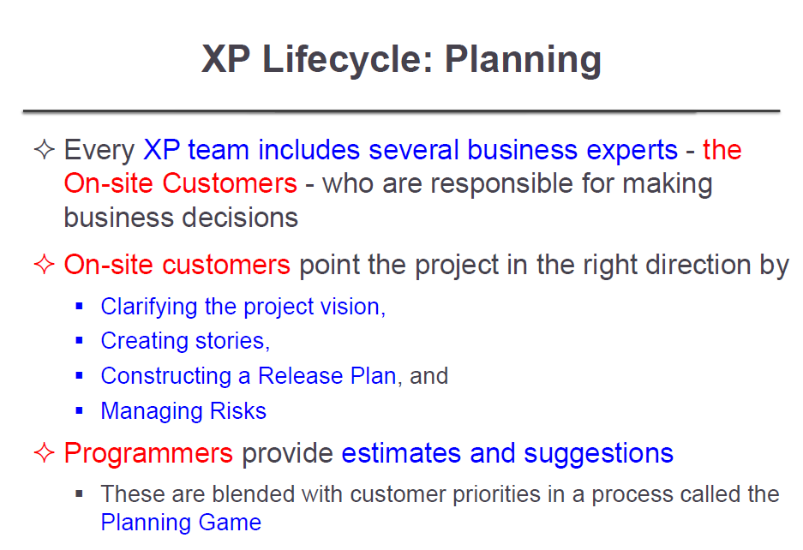

Slide 10
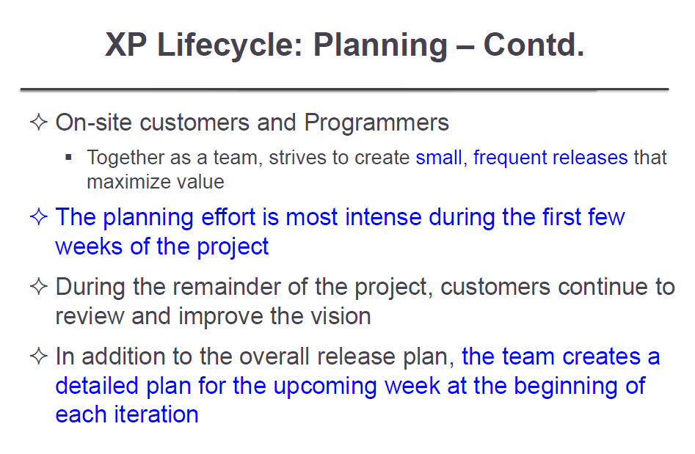

Slide 11
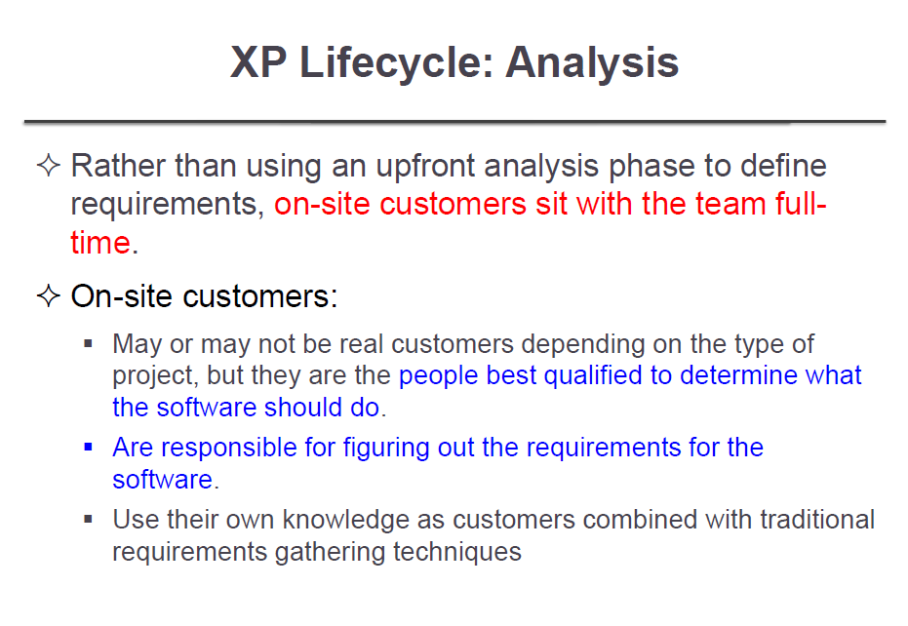

Slide 12
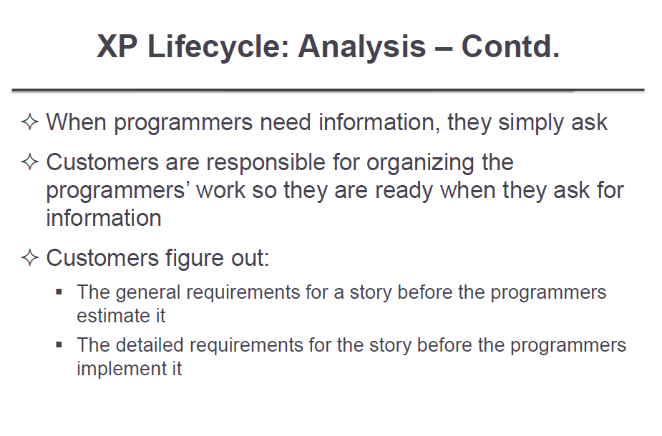

Slide 13
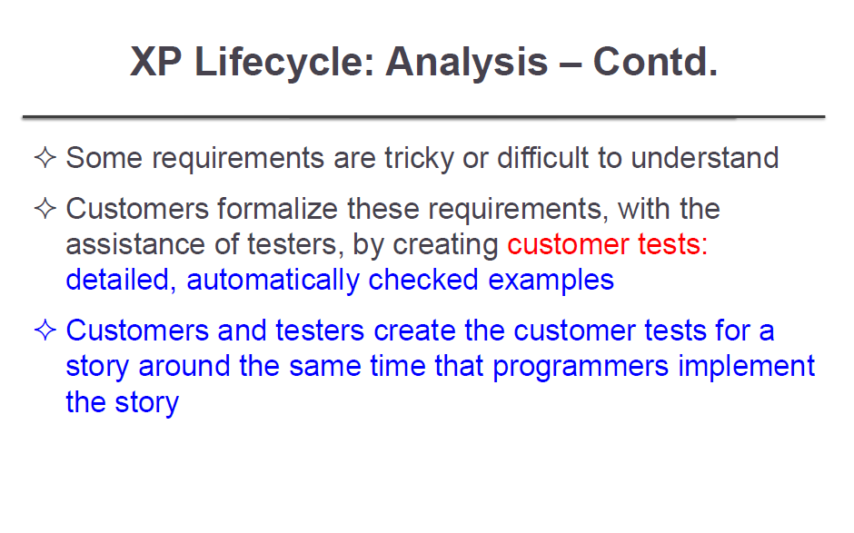

Slide 14
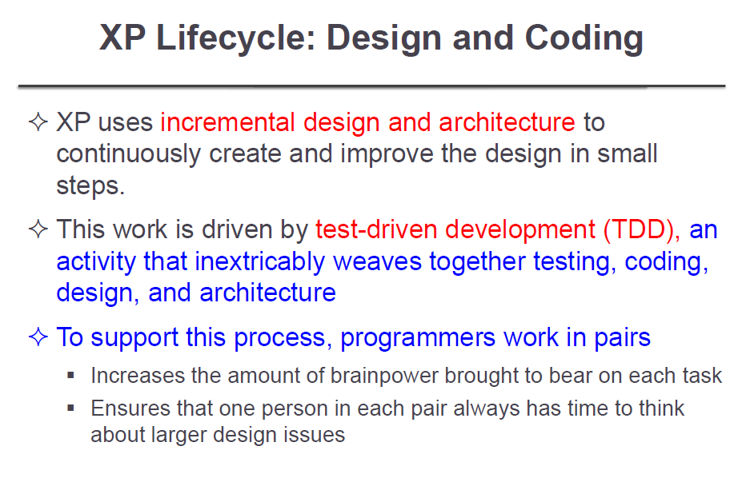

Slide 15
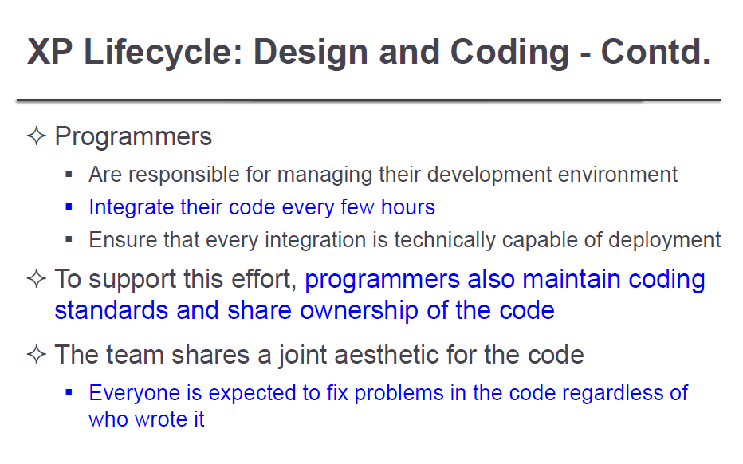

Slide 16
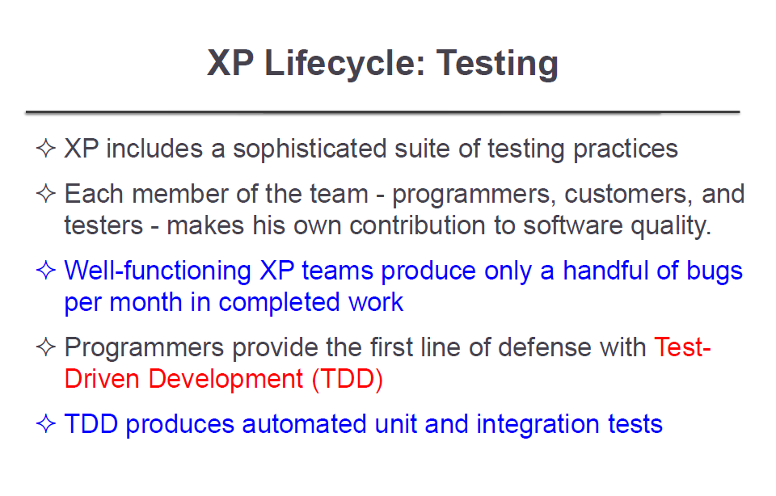

Slide 17
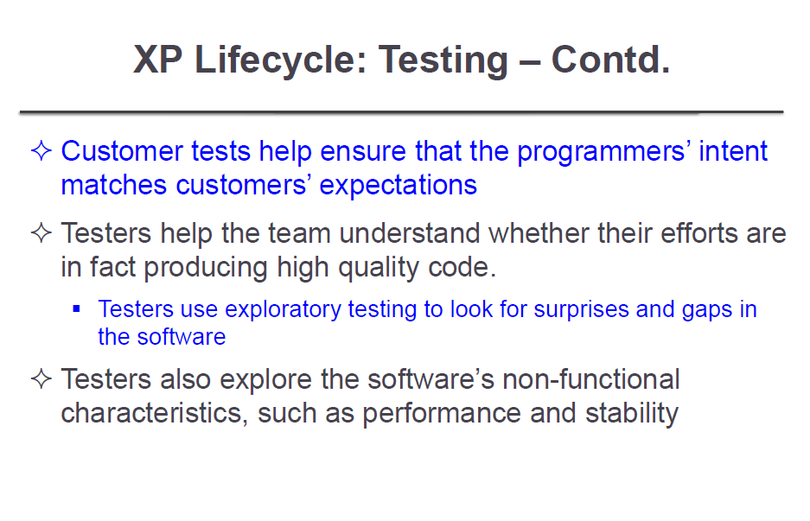

Slide 18
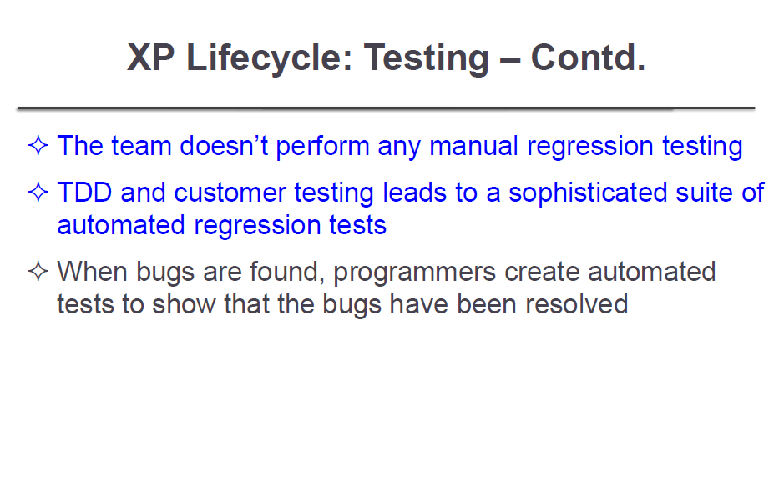

Slide 19
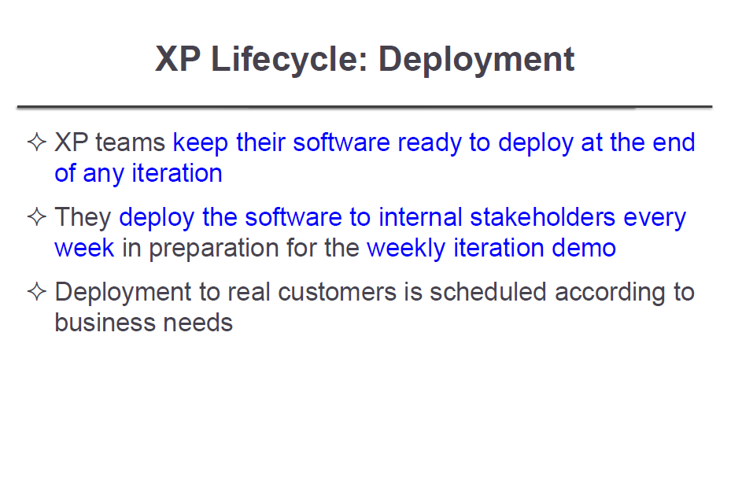

Slide 20
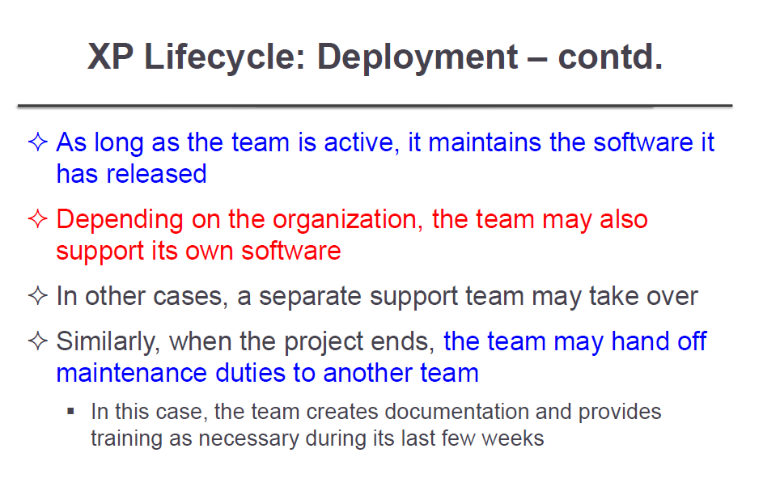

Slide 21
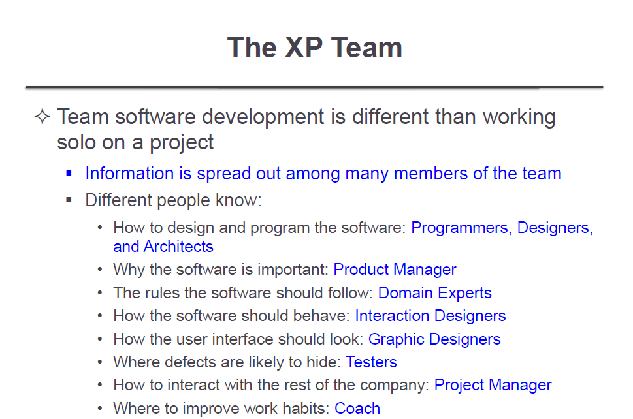

Slide 22
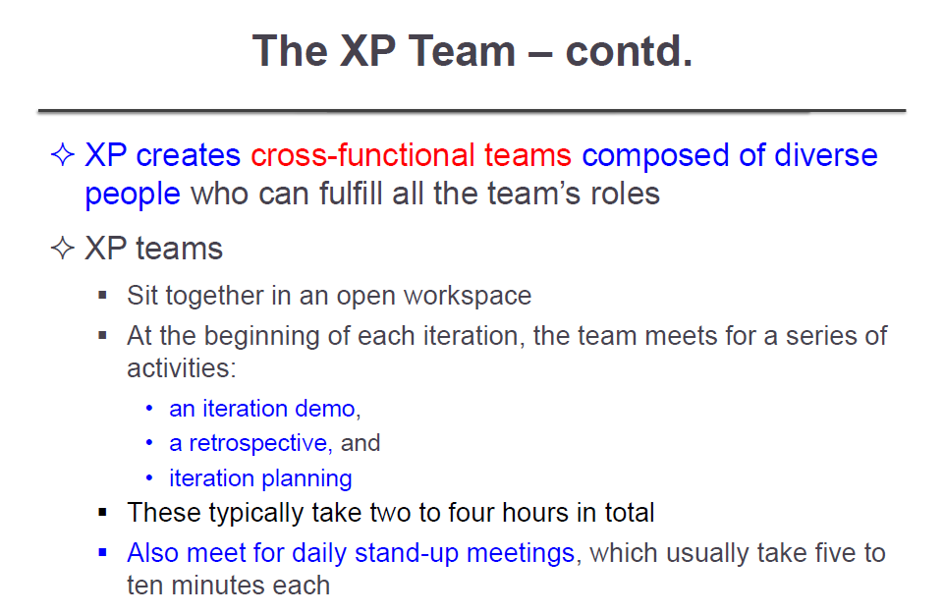

Slide 23
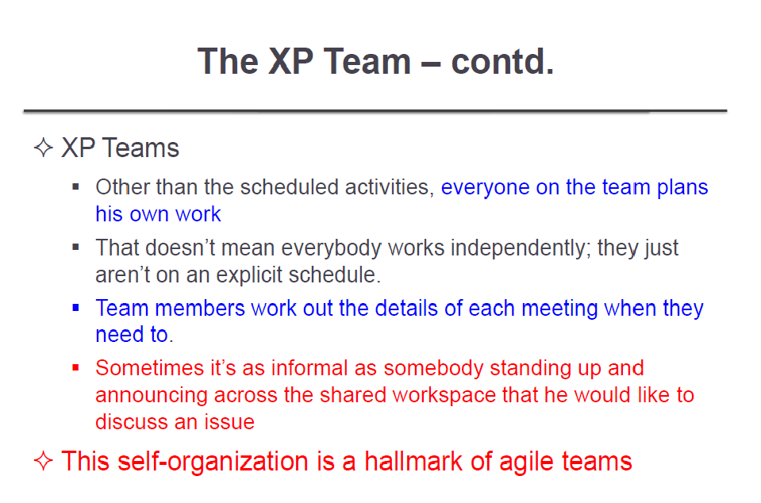

Slide 24
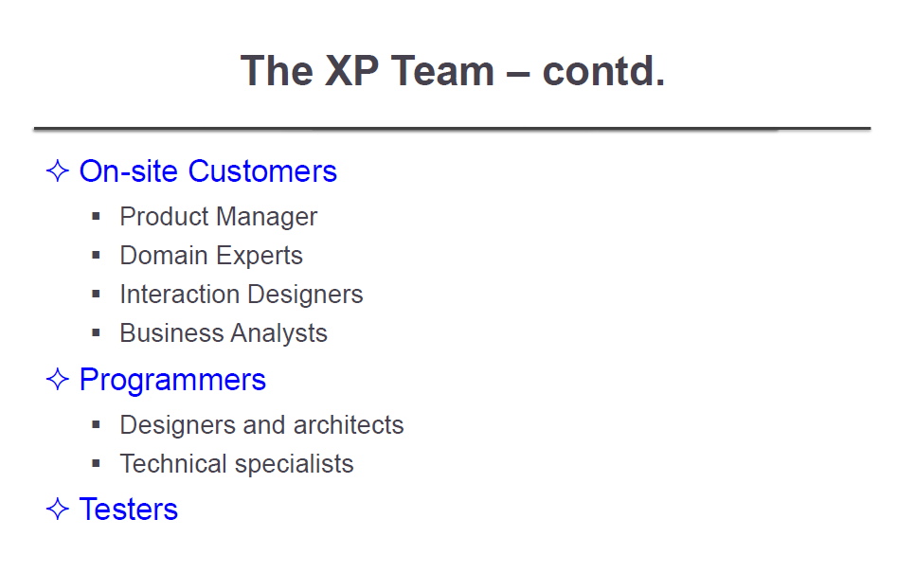

Slide 25
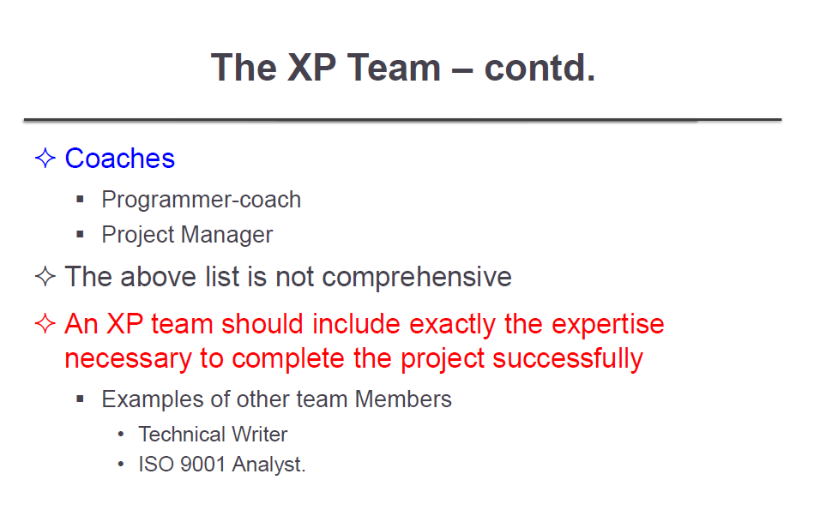

Slide 26
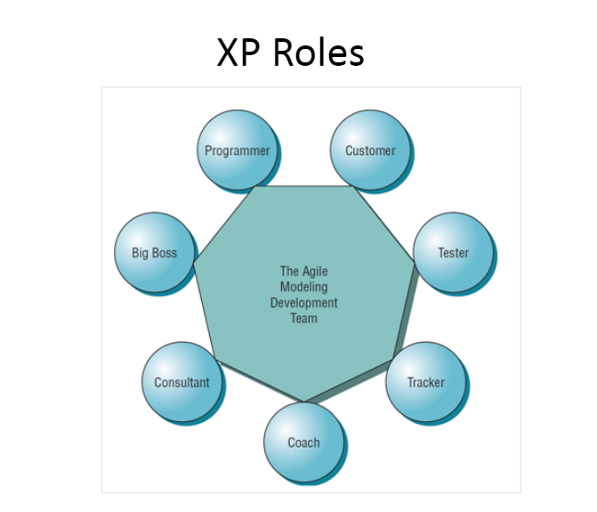

Slide 27
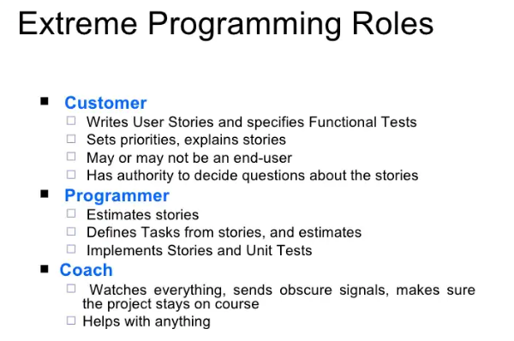

Slide 28
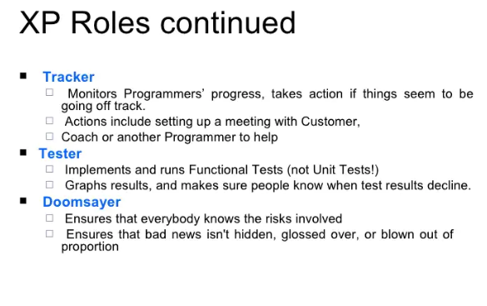

Slide 29
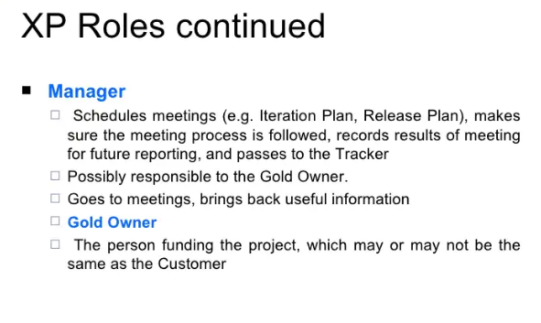

Slide 30
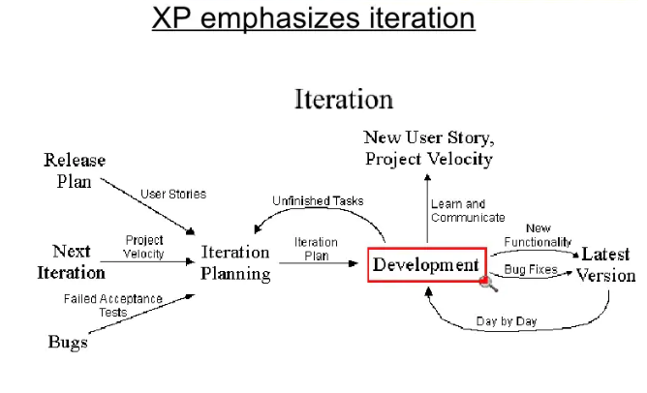


Slide 31
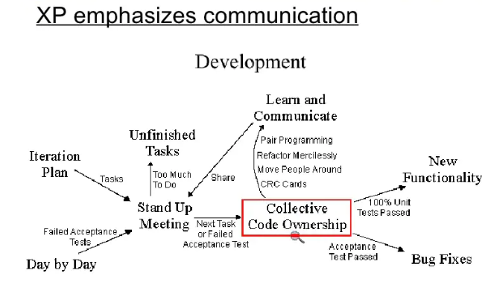

Slide 32
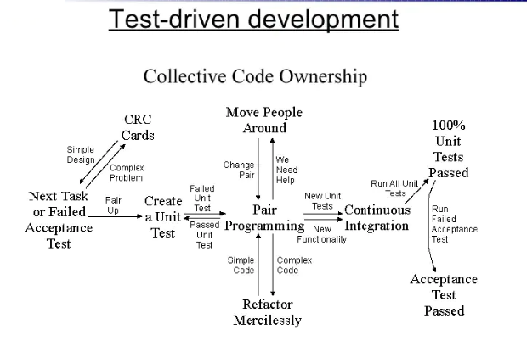

Slide 33
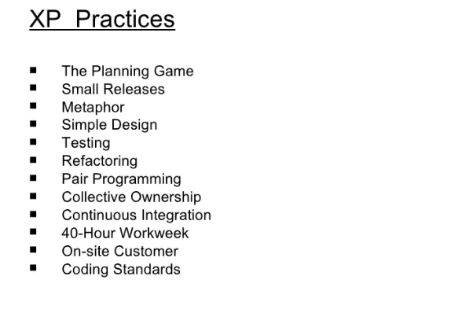

Slide 34
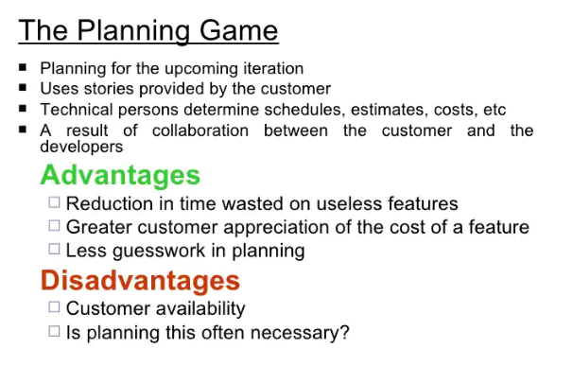

Slide 35
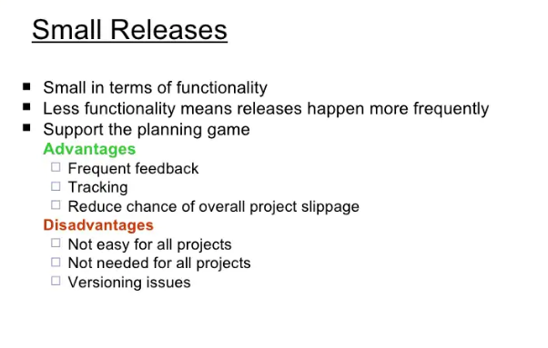

Slide 36
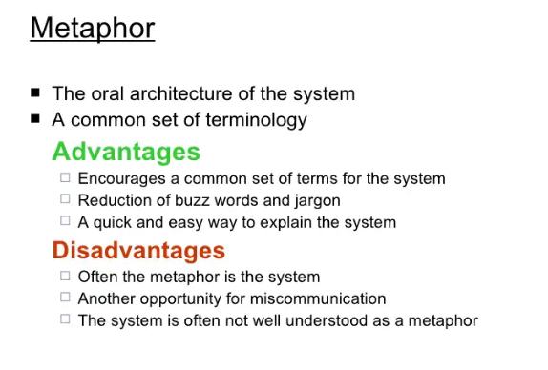

Slide 37
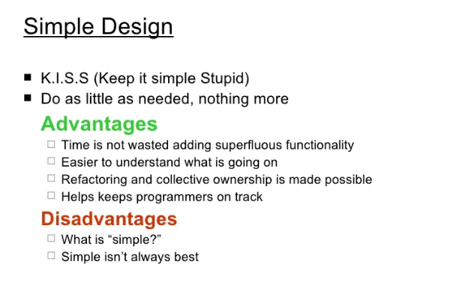

Slide 38
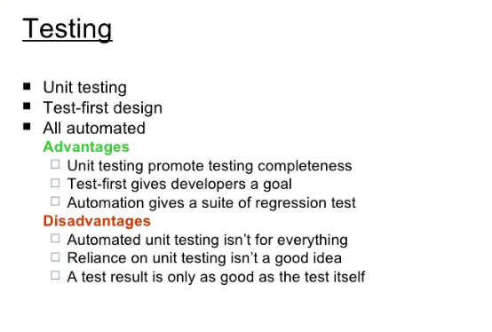

Slide 39
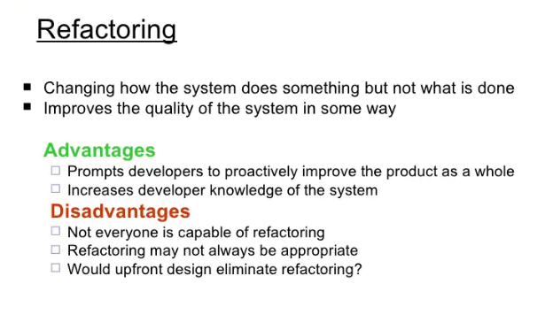

Slide 40
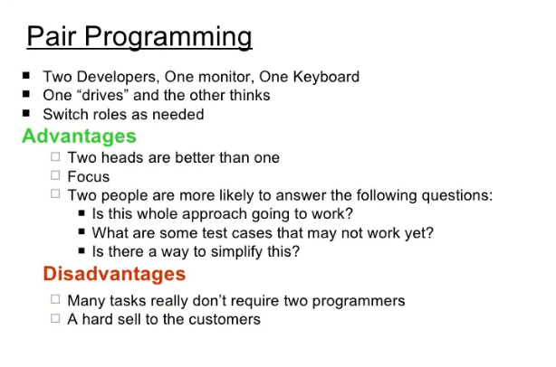

Slide 41
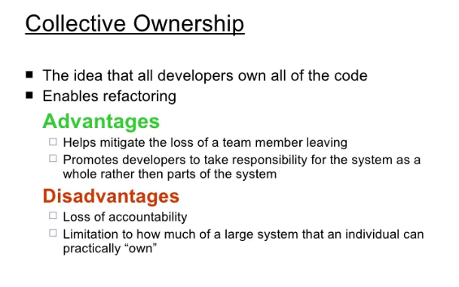

Slide 42
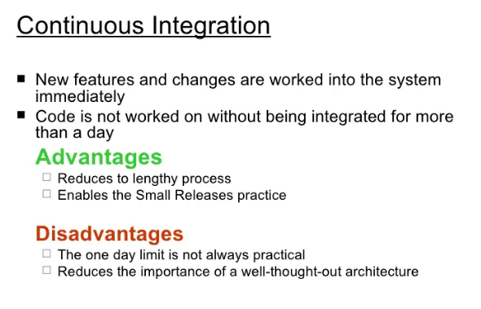

Slide 43
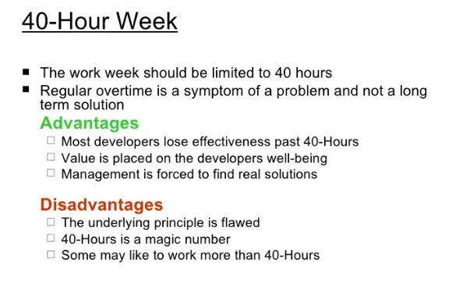

Slide 44
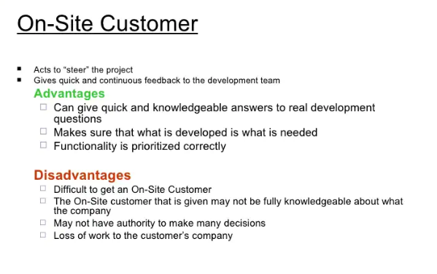

Slide 45
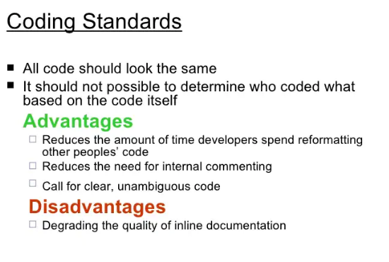

Slide 46
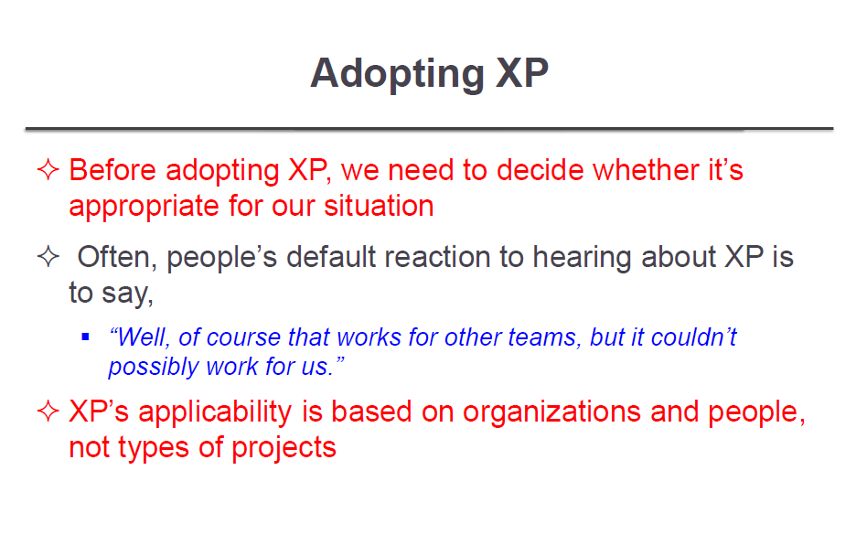

Slide 47
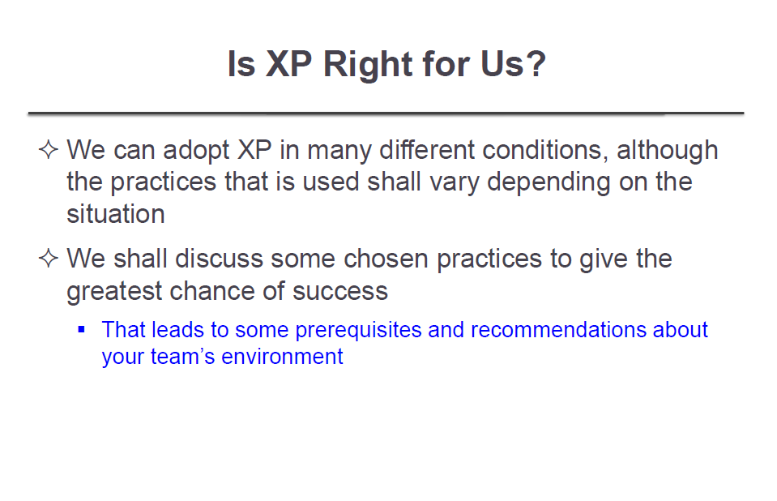

Slide 48
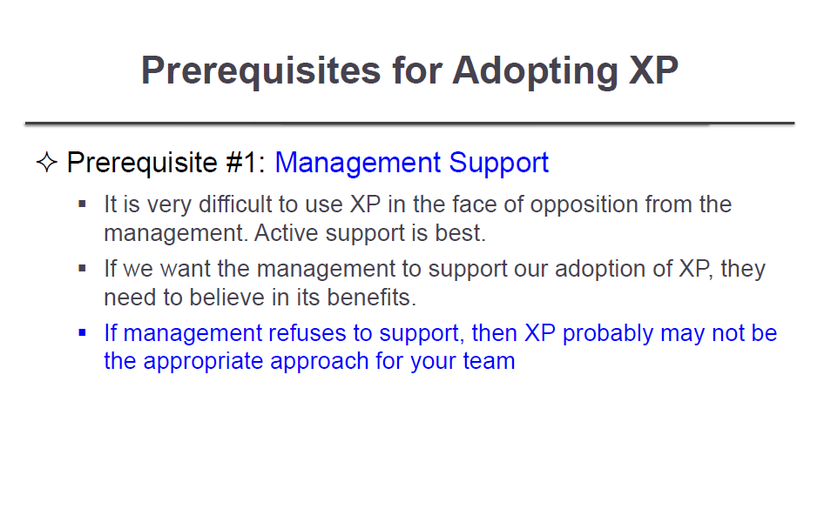

Slide 49
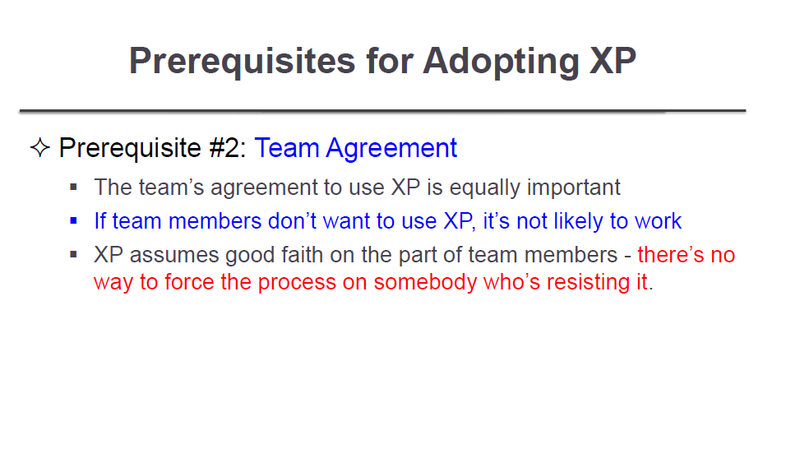

Slide 50
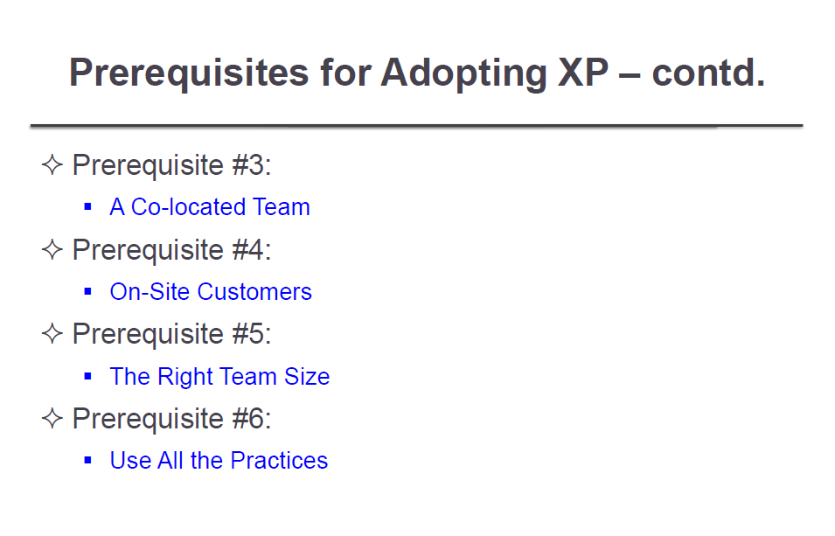

Slide 51
Prerequisite #3: A Colocated Team
XP relies on fast, high-bandwidth communication for many of its practices. In order to achieve that communication, your team members needs to sit together in the same room.
If your team isn’t colocated...
Colocation makes a big difference in team effectiveness. Don’t assume that your team can’t sit together; be sure that bringing the team together is your first option.

Slide 52
Prerequisite #4: On-Site Customers
The on-site customers’ decisions determine the value of the software.
On-site customers are critical to the success of an XP team. They, led by the product manager, determine which features the team will develop. In other words, their decisions determine the value of the software.

Slide 53
Prerequisite #5: The Right Team Size
For teams new to XP, however, they recommend 4 to 6 programmers and no more than 12 people on the team .
They also recommend having an even number of programmers so that everyone can pair program If you have ongoing support needs, add one more programmer for a total of five or seven so that the team can have a batman.
Teams with fewer than four programmers are less likely to have the intellectual diversity they need. They’ll also have trouble using pair programming, an important support mechanism in XP.
Large teams face coordination challenges.
Although experienced teams can handle those challenges smoothly, a new XP team will struggle.

Slide 54
Prerequisite #6: Use All the Practices
You may be tempted to ignore or remove some XP practices, particularly ones that make team members uncomfortable. Be careful of this.
XP is designed to have very little waste. Nearly every practice directly contributes to the production of valuable software.
For example, pair programming supports collective code ownership, which is necessary for refactoring. Refactoring allows incremental design and architecture.
Incremental design and architecture enables customer-driven planning and frequent releases, which are the key to XP’s ability to increase value and deliver successful software.

Slide 55
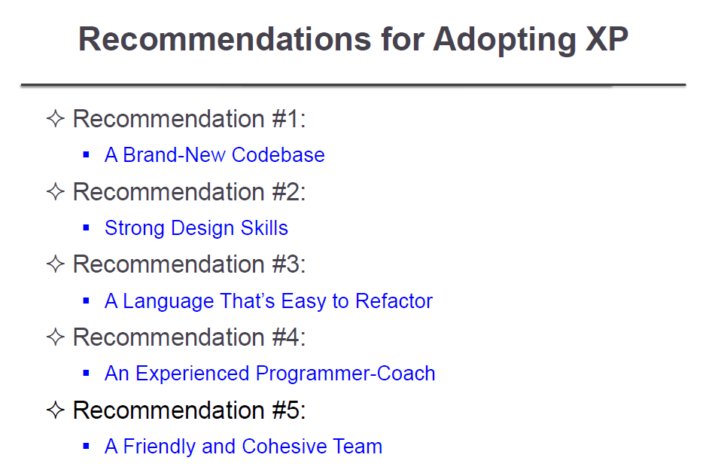

Slide 56
Recommendation #1: A Brand-New Codebase
Easily changed code is vital to XP. If your code is cumbersome to change, you’ll have difficulty with XP’s technical practices, and that difficulty will spill over into XP’s planning practices.
XP teams put a lot of effort into keeping their code clean and easy to change. If you have a brand-new codebase, this is easy to do.
Recommendation #2: Strong Design Skills
Simple, easily changed design is XP’s core enabler. This means at least one person on the team—preferably a natural leader—needs to have strong design skills.
It’s hard to tell if somebody has strong design skills unless you have strong design skills yourself.

Slide 57
Recommendation #3: A Language That’s Easy to Refactor
XP relies on refactoring to continuously improve existing designs, so any language that makes refactoring difficult will make XP difficult. Of the currently popular languages, object-oriented and dynamic languages with garbage collection are the easiest to refactor. C and C++, for example, are more difficult to refactor.
If your language is hard to refactor...
You can still use XP, but it’s a good idea to include someone on your team who has experience with refactoring in your language, if you can.

Slide 58
Recommendation #4: An Experienced Programmer-Coach
Some people are natural leaders. They’re decisive, but appreciate others’ views; competent, but respectful of others’ abilities. Team members respect and trust them. You can recognize a leader by her influence—regardless of her title, people turn to a leader for advice.
Leadership is independent of title or position. You can identify leaders by their followers, not by their desire to give orders. To identify the real leaders on your team, look for the people that team members want to follow.

Slide 59
Recommendation #5: A Friendly and Cohesive Team
XP requires that everybody work together to meet team goals. There’s no provision for someone to work in isolation, so it’s best if team members enjoy working together.
If your team doesn’t get along...
XP requires people to work together. Combined with the pressure of weekly deliveries, this can help team members learn to trust and respect each other.

